Slide 1
TRADITIONAL VS LATEST METHODOLOGIES
By,
Thirumalini R

Slide 2
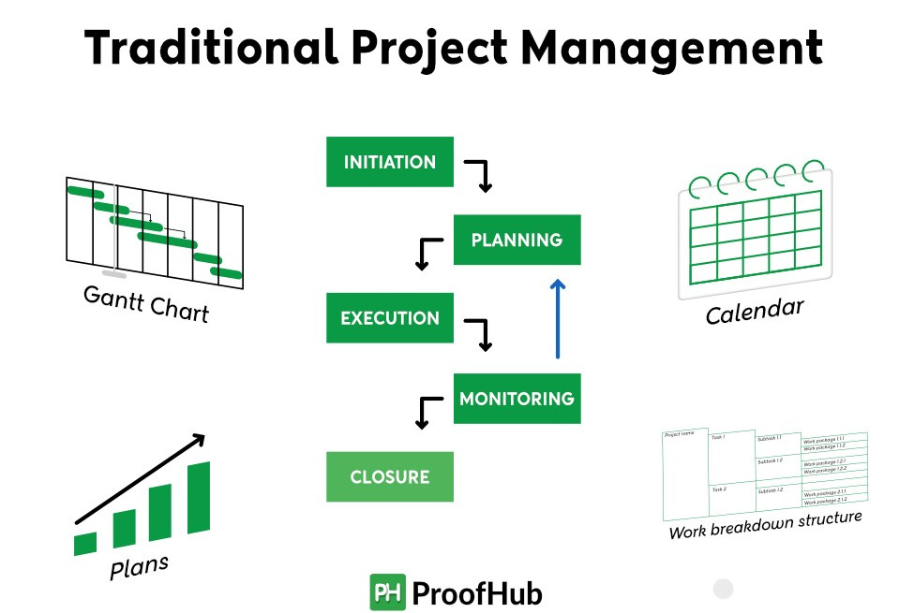
Traditional Methodologies
Objectives:
• Process
• Advantages & Drawbacks

Slide 3
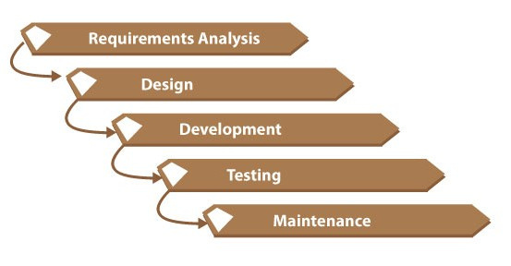
Traditional Methodologies Example
Waterfall model
Objectives
Plan Everything Upfront
Predictable, Linear Process
Deliver Full Product at the End

Slide 4
Pros & Cons of Traditional Methods
Advantages
Drawbacks
Clear Structure
Good for Fixed Requirements
Easier to Manage Early
Inflexible to Change
Late Testing, Late Feedback
Higher Risk of Failure

Slide 5
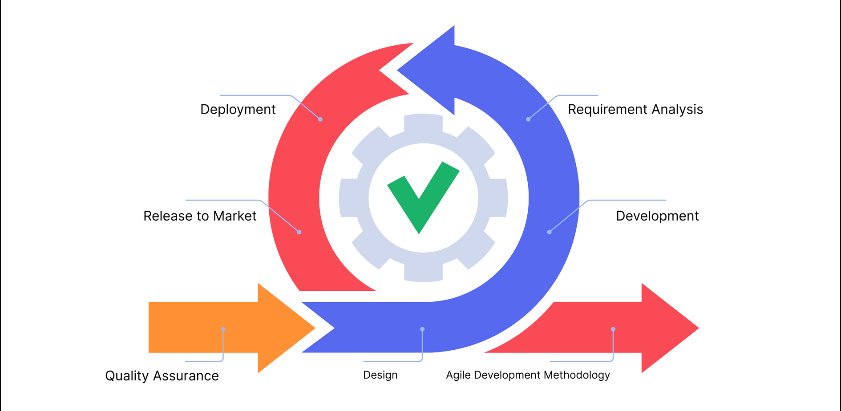
Latest Methodologies
Agile
Scrum
Modern Practices

Slide 6
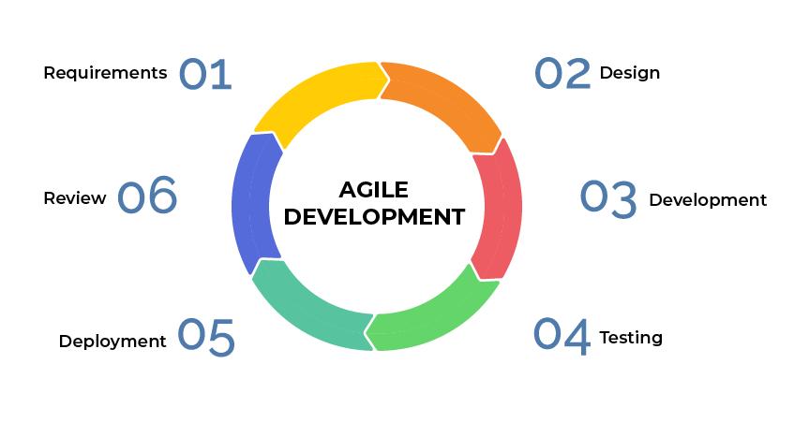
Latest methodologies example
Agile:
Objective of Agile
Respond Quickly to Change
Deliver Working Software Fast
Collaborate with Customers Regularly

Slide 7
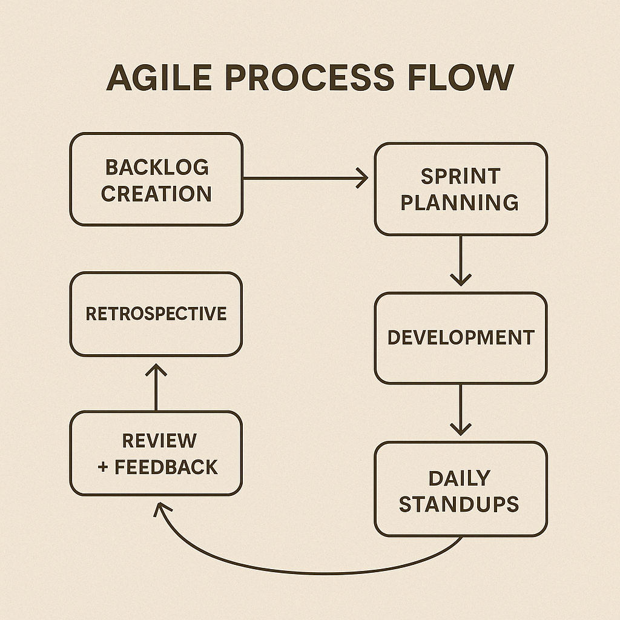
Flowchart of Agile

Slide 8
How Modern Methods Overcome Traditional Drawbacks
Traditional Drawback
Modern Solution
Inflexibility
Late Testing
Fixed Scope
Lack of Feedback
Agile Iterations
Continuous Integration
Evolving Backlog
Customer Involvement

Slide 9
Thank you!

